Slide 1
SE450 Final Project Design
Anna Andler || 11-16-2023

Slide 2
Overview of the System
Server-Side (Backend)
Client-SIDE (FRONTEND)
Written in Java
eCommerce Server Thread
Server Socket: TCP 8080
Client Handler Worker Thread
“External Vendor” Payment Server Thread
Server Socket: TCP 8081
Payment Worker Thread
Asynchronous threads
Written in HTML, CSS, and JavaScript (limited)
Access via Client Browser -
Tested with Firefox + Microsoft Edge
Flexible Resize Windows
Dynamic Products + Cart Pages
Auto redirects as form submission requires
Multi-client access over local network and possibly internet

Slide 3
Overall Design Requirements
SOLID Principles
Design patterns
Single Responsibility Principle (SRP):
Open/Closed Principle (OCP):
Liskov Substitution Principle (LSP):
Interface Segregation Principle (ISP):
Dependency Inversion Principle (DIP):
Singleton Design Pattern:
Shopping Cart.
Logger*
Product Catalog*
Factory Design Pattern:
ProductFactory
Builder Design Pattern:
CartBuilder
*not a requirement, but I did it anyway

Slide 4
Database Design

Slide 5
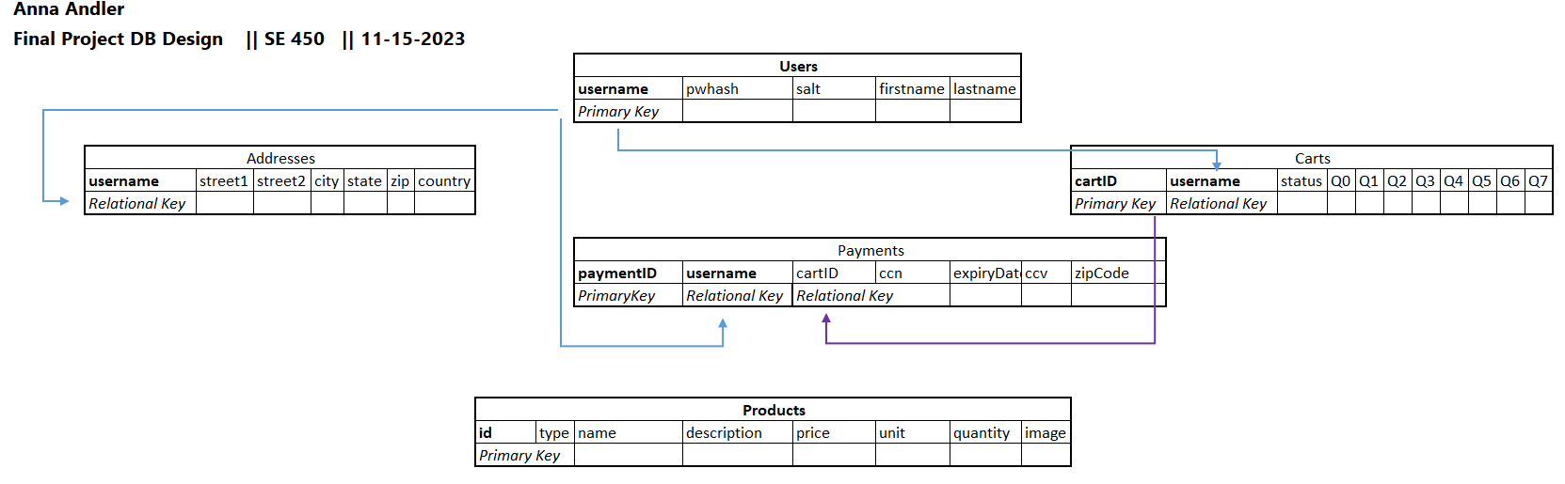
Database System
File-based: comma-delimited
Not encrypted ☹
Access using Repositories via Database Object

Slide 6
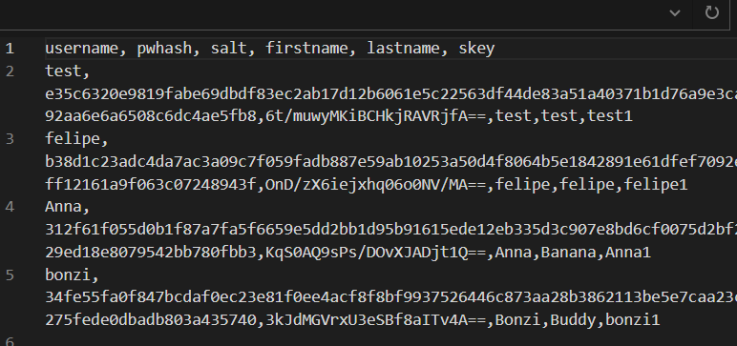
User Database
Primary Key: username (must be unique)
Representation:
User class
Access:
UserRepository has a Database
Security Features:
Passwords are hashed and salted
SHA512 Hash
Random 16-bit salt

Slide 7
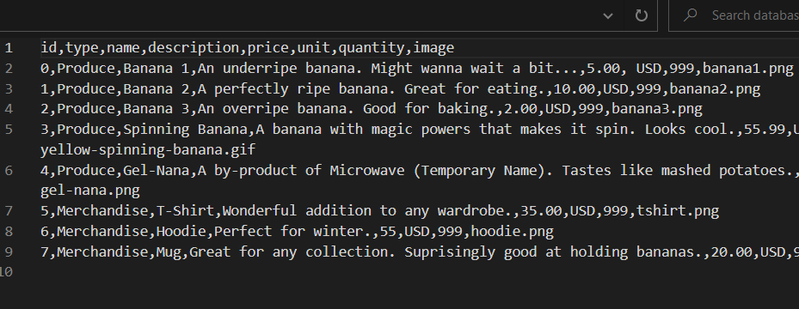
Products Database
Primary Key: productID (must be unique)
*statically modified
Representation:
Product interface (single row)
Merchandise + Product objects
ProductCatalog (entire DB)
Access:
ProductRepository has a Database

Slide 8
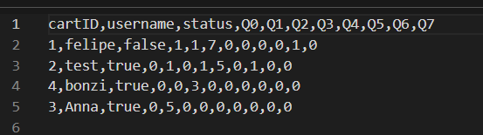
Cart Database
Primary Key: cartID (must be unique)
Relational Key: username
Representation:
Cart Class
Cart Builder
Access:
CartRepository has a Database

Slide 9
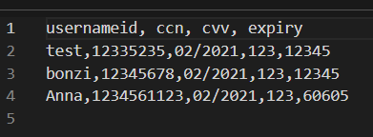
Payment Database
Not PCI-DSS Compliant ☹
Primary Key: paymentID (must be unique)
Relational Key: username
Representation:
Payment Class
Access:
PaymentRepository has a Database

Slide 10
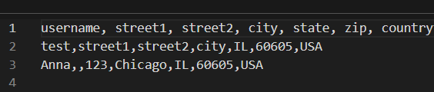
Address Database
Primary Key: addressID (must be unique)
Relational Key: username
Representation:
Address Class
Access:
AddressRepository has a Database

Slide 11
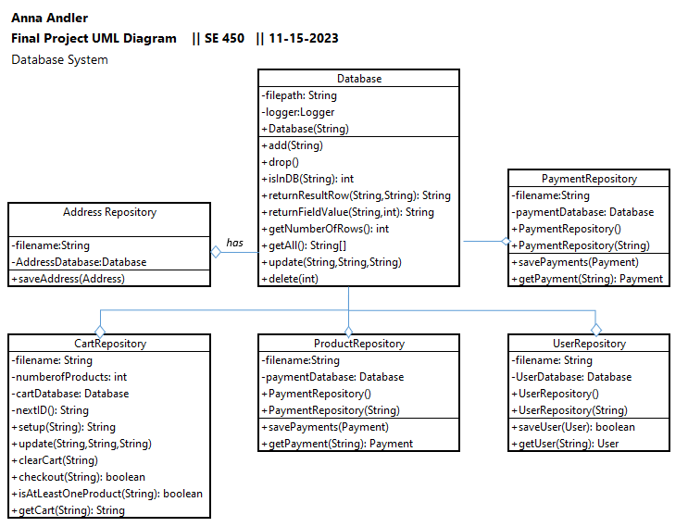
Database System
Object Repositories
Have Database object to access their respective database: e.g. users.txt
All repositories need to be able to:
Add rows
Update rows
Delete rows
Find rows

Slide 12
Program Design

Slide 13
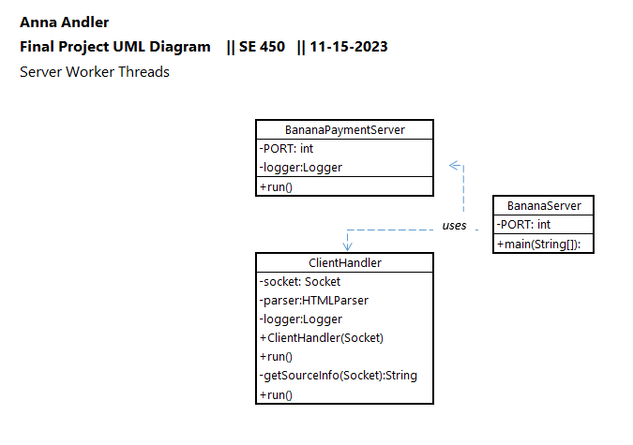
SERVER THREADS
Server main execution thread.
java BananaServer
Starts the Payment Server
While running:
Accept client connection
Start Client Worker thread to process
Log any errors to log/error.log
Single point of execution for all program components

Slide 14
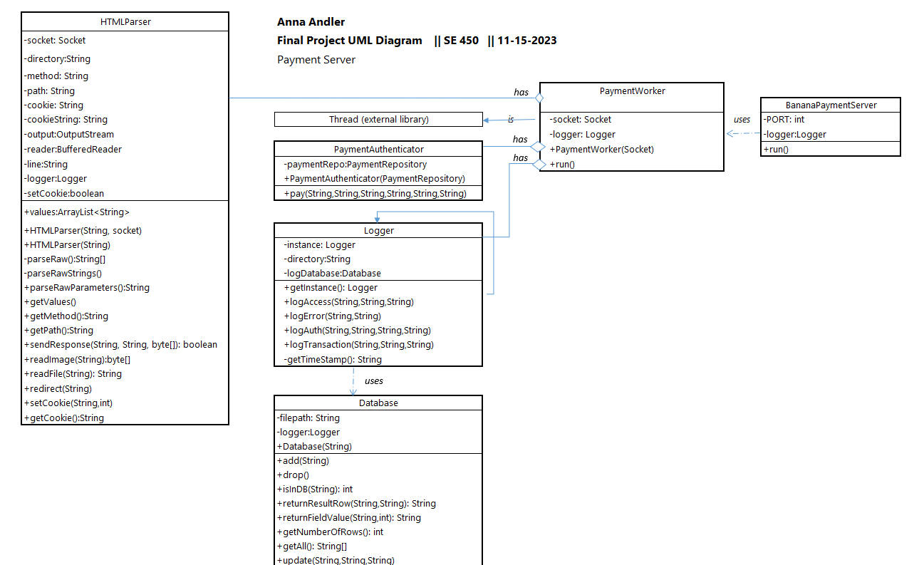
PAYMENT Worker
payment server async execution thread
Extends qualities from Thread lib
Extract HTML request parameters
If payments.html path:
Send web form
If payments path:
Process web form
Redirect to site
Log any errors to log/error.log
Report to payment server
End

Slide 15
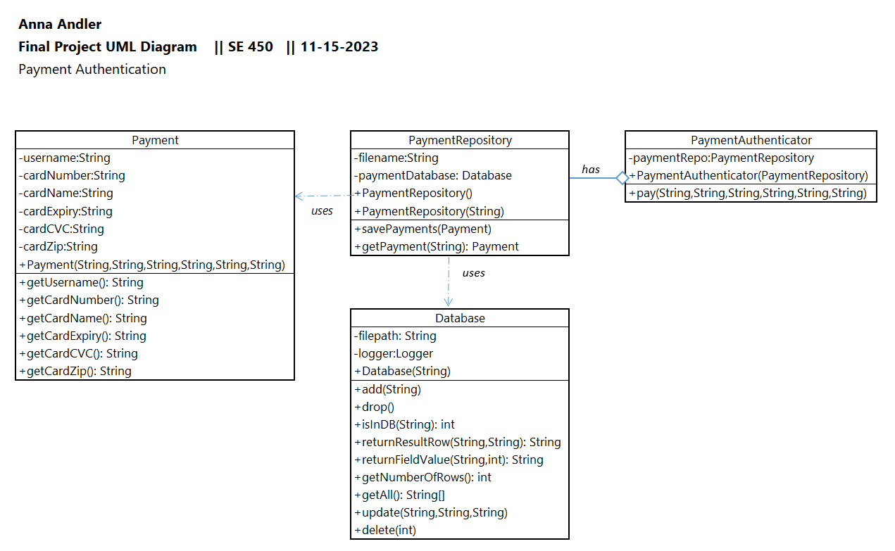
Payment Authentication
Action: Payment Worker calls upon Payment Form Submission
Goal: authenticate submitted payment data
Design:
Payment Database Repository to retrieve/ update Payment objects stored in the database
Logs any errors

Slide 16
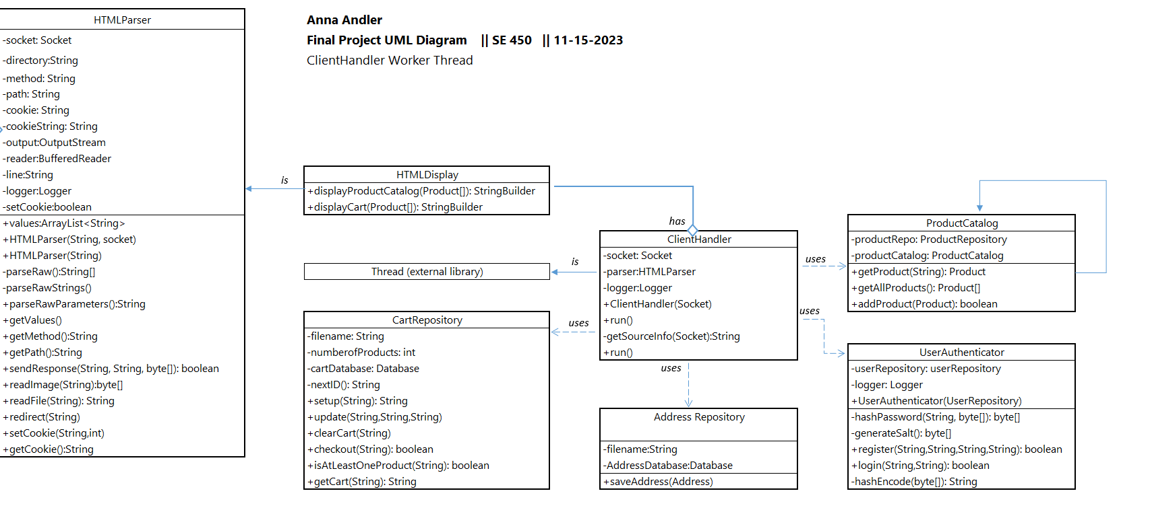
Client Worker
eCommerce server async execution thread
Extends qualities from Thread lib
Extract HTML request parameters
Restore existing session (optional)
If form submission:
Access Path Form Repository
Redirect to proper page
If static page:
Send page contents
Log errors
Report to server
End

Slide 17
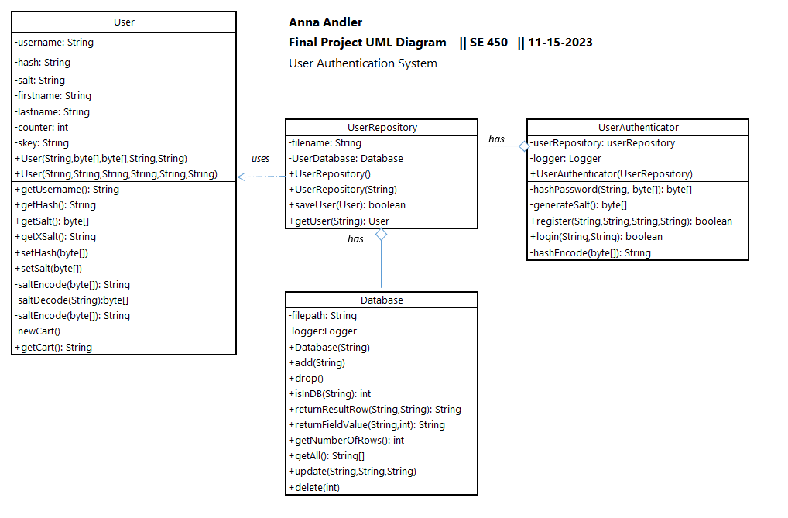
User Authentication
Action: Client Worker calls upon Login Form Submission
Goal: authenticate new/existing users
Design:
User Database Repository to retrieve/ update User objects stored in the database
Compares given password to one stored in database via hashing+salt functions

Slide 18
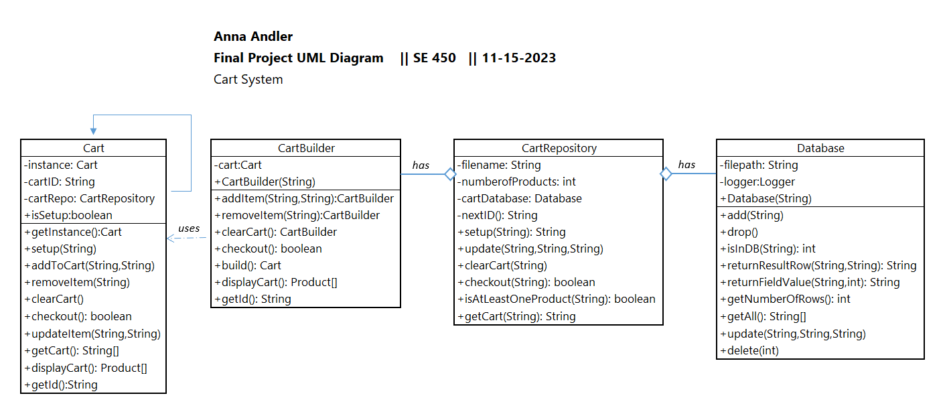
Cart System
Action: Client Worker calls upon Cart Update
Goal: update cart data (products + status) for a user
Design:
Singleton Cart Object
CartBuilder – interface for updating the cart
Cart Repository for retrieving/modifying Cart objects stored in the database

Slide 19
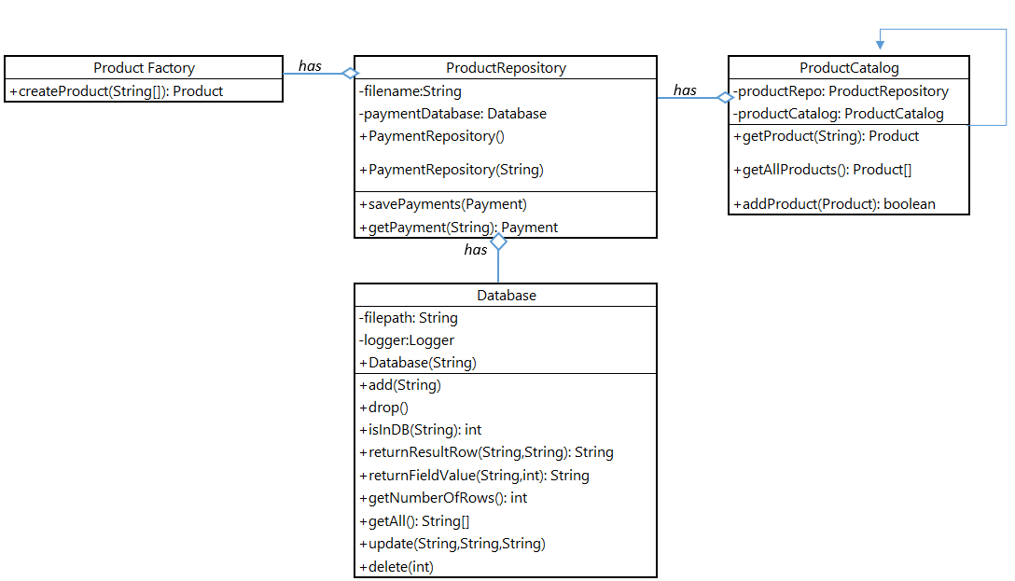
Product System
Action: Client Worker calls upon Product Retrieval
Goal: retrieve product inventory
Design:
Singleton ProductCatalog
ProductFactory – for creating Products
Product Repository for retrieving/modifying Product objects stored in the database

Slide 20
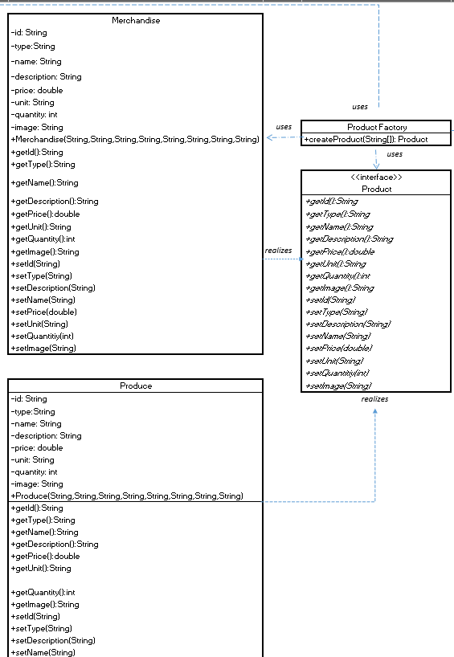
Product Factory
Action: ProductCatalog calls upon product retrieval
Goal: create products of the appropriate type
Design:
Factory for creating products:
Merchandise
Produce
Product Interface to ensure qualities for products
Merchandise + Produce

Slide 21
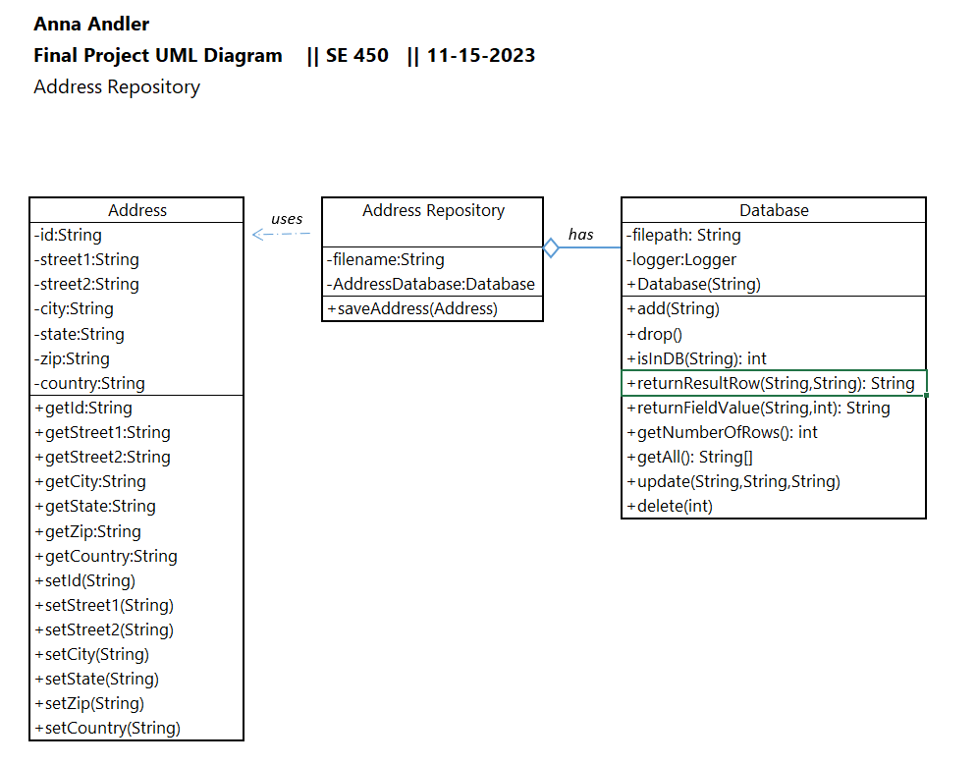
Address System
Action: Client Worker calls upon Address Form Submission
Goal: update order addresses for a user
Design:
Address Database Repository to retrieve/ update Address objects stored in the database

Slide 22
Junit Testing

Slide 23
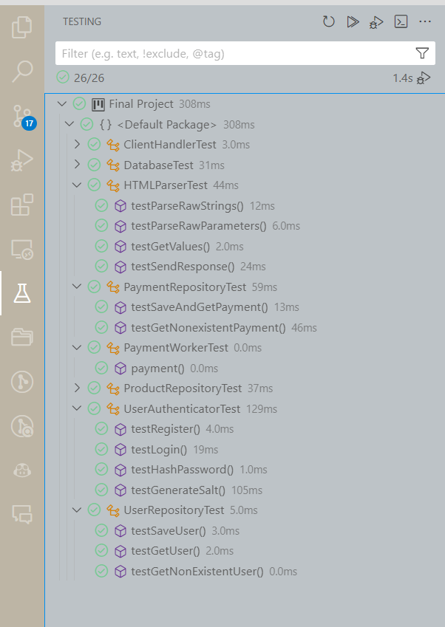
Junit Testing
Goal: Boundary testing for critical functions to confirm behavior
DatabaseTest
add, remove, update, find functions
HTMLParserTest
parse parameters, parse form values, send response
PaymentRepositoryTest
pay, update
ProductRepositoryTest
getall, find, add, remove
UserAuthenticatorTest
login, register, hash, generate salt
UserRepositoryTest
add, find

Slide 24
Github Code Repository
Project Structure
https://github.com/kogatana-x/SE450/tree/Final
Readme for program usage and design summary
BananaServer.jar – java executable for running the server
Final Project folder containing project source files
https://github.com/kogatana-x/SE450/tree/Final/Final%20Project
Java Project Files
Html/ - eCommerce Server Front-end HTML
Payment-html/ - Payment Server Front-end HTML
Database/ - Database files
Logs/ - Log files
Readme for client web walk-through

Slide 25
Application Run-Through
Server-Side Execution
Client-Side Access
javac BananaServer.java
java BananaServer
http://localhost:8080
NOTE: Payment server access redirects to “External Payment Vendor” on:
http://localhost:8081

